Slide 1


Machine Learning with R using Qualitative Research Codes
Marla Stuart, PhD, MSW
Fellow, Berkeley Institute for Data Science
Fellow, Guizhou Berkeley Big Data Innovation Research Center
March 13, 2019
Notes:
11:30-11:40 = Berkeley Time
11:40-11:45 = D-Lab Welcome
11:45-11:50 = Introductions and Agenda
11:50-12:00 = Qualitative Research Coding & Analysis
12:00-12:25 = Machine Learning with R using Qualitative Research Codes
12:25-12:50 = Q&A
12:50-13:00 = Wrap-Up & Evals

Slide 2
It’s Okay Not to Know (IOKN2K)
280 workshops
1,100 consultations
working groups
special research projects
approx. 6,000 scholars served per year
Notes:
5 minutes
workshops on R, python, qual methods, etc.
couple to a few dozen consultants providing around 1100 consultations per year
working groups: Digital Humanities, Education, Cloud Computing, Computational Text Analysis, Learning Analytics, Blockchain/Cryptocurrency, Qualitative Methods, Python & Machine Learning…
working groups range from 10 to 30, with an average of 12 participants, meeting an average of twice per month
special research projects include Hate Speech, College-Going Patterns, Digital Refugees, & Digital Humanities Projects, such as Louisiana Slave Conspiracies

Slide 3
Agenda
Introductions
Qualitative Research Coding & Analysis (Josué)
Machine Learning with R using
Qualitative Research Codes (Marla)
Exporting Code Counts into Excel
Grouping Data Sources using R
?
?
?
?
?
Notes:
5 minutes
Introductions & Agenda (5 minutes)
Qual Research Coding & Analysis (10 minutes)
Machine Learning with R using Qual Research Codes (50 minutes, including Q&A)

Slide 4
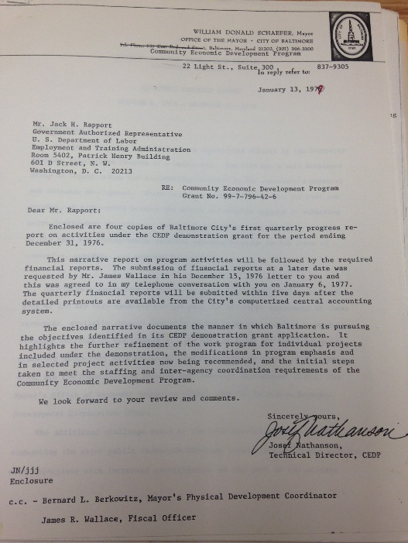
Qualitative Research Coding & Analysis What are Codes? What is Coding
Coding is a way of organizing the data around some common idea, concept, or category ACROSS sources.
The code of “financial planning” is applied to the selected text from documents A, B, and C, because they all discuss this topic.
A B C
Notes:
3 minutes
Use example of blue text being a code of “program development” and orange text being the code of “program termination” and then discuss how these codes can help us understanding different concepts/ideas…
Deductive and Inductive Coding You create codes because you deem the identified topics/concepts/ideas as important and relevant to your study. Deductive Coding: Codes emerge from your research question and/or the literature review. Inductive Coding: Codes emerge through engagement with your actual data sources and/or data set.
Defining Codes Your codes should be defined, just as variables in a quantitative study should be defined. The level of specificity will depend on various factors, such as the complexity of your coding scheme, whether you have a team of coders or are conducting coding on your own, requirements of your field or committee or journal of choice… Inclusion/Exclusion Criteria, Weighing Scale
Organization of Coding Scheme Whether deductive or inductive, codes are organized into a coding scheme that you then use to systematically identify relevant segments of data within your entire data set. Flat Coding: Codes are organized at the same conceptual level. Hierarchical Coding: Codes are organized into groups and subgroups based on whatever conceptualization the researcher deems appropriate/relevant.

Slide 5
Qualitative Research Coding & Analysis
Multi-Step Nonlinear Process
Coding
Unit of Analysis
Metadata
Research Questions
Literature or Theory
Data
Codes
Memos
Notes:
2 minutes
Different researchers engage the coding process in different ways… However you choose to create and organize codes, you should expect it will be a multi-step process, maybe 4, 5, or more rounds, and that there will be a great deal of “back-and-forth” throughout the process.

Slide 6
Qualitative Research Coding & Analysis
Best Practices
Treat Coding as an Iterative Process
Test and Revise Codes
Review Coding Process
Actively Work with 20-30 Codes at a Time
Break Up the Coding Process
Keep a Codebook
Memo as You Code
Notes:
1 minute
Treat Coding as an Iterative Process Test Codes and Revise: Look for codes that aren’t being used, aren’t distinct enough from other codes, are defined too broad or too specific… Review Coding Process: Make sure you and other coders are being consistent in your application of the codes across the data set.
Actively Work with 20-30 Codes at a Time You’ll likely have more than 20-30 codes, but should actively code with only 20-30 codes to ensure consistency.
Break Up the Coding Process You can code for a specific chapter rather than the whole dissertation/book. You can split the codebook thematically, and code in rounds.
Keep a Codebook Include information noted on “Defining Codes” slide, and regularly refer back to it. This is a living document that should be revised as needed.
Memo as You Code Make notes reflecting on the coding process, perhaps noting ideas for codes that aren’t yet included and/or revisions to existing codes. You may also write analytic memos, making a note that reflects initial thoughts about the meaning of your work (i.e., preliminary analysis)

Slide 7
Qualitative Research Coding & Analysis
What is Analysis?
Analysis
Unit of Analysis
Metadata
Research Questions
Literature or Theory
Data
Codes
Memos
Analysis Plan
Code/Query Output
Memos
Notes:
2 minutes
The process of identifying themes related to your research findings. This is different than identifying ideas/concepts/topics that come up throughout your data set. It’s “bigger picture” stuff…
Overarching Themes: What is happening in your data overall? Subgroup Themes: What is happening in your data for specific subgroups? Typology Themes: What is happening in your data by specific dimensions of coded data?
for typology, give example of financial planning and program development… where you may notice there are certain groups of administrators or certain agencies or certain cities (whatever your studying) that approach financial planning and program development for social services in different ways… Perhaps you notice some are social justice oriented, making decisions based primarily on client/community needs, others are fiscally driven, making decisions based primarily on maintaining a balanced budget, while others may be incentive driven, making decisions focused on disincentivizing the use of social welfare and incentivizing the use of work. Your may divide your data into three typologies: social justice oriented, fiscally oriented, and work incentive oriented.
An analysis plan is a living document that you revise as you discover new questions, add codes to the codebook, and revise your plan based on null findings. The plan should document:
Research Question(s) You Want to Answer: Identify Specific Question(s) to Answer
Codes, Attributes, and Queries You’ll Use to Answer Each Question (identify which of these to use to answer each question)
Relevant Themes, Subgroups, and Typologies
Multi-Step Nonlinear Process These questions will be more specific than the research questions that motivate your study, and will focus on your actual data. Identify Codes, Attributes, Subgroups, Typologies, and Queries Associated with the Specific Questions Which help answer the specific question? What aspects of these are you interested in? What unit of analysis is important to answer your question (e.g., individual or group, stakeholder type, document of a particular era)?
If you have a hypothesis, plan to test both to prove and disprove. How might the concepts/ideas/categories for which you coded contribute to your research question?

Slide 8
QDA Software as a Tool for Coding & Analysis
What It Does
Structure & Organize
Code & Retrieve
Memo
Explore
Query
Visualize
Potential Benefits
Frees Time to Focus on Analysis
Can Deal with Large Data Sets
Improves Auditability
(among some audiences)
Improves Credibility
(among some audiences)
What It Does Not
Error-Free Auto Coding
Analytic Thinking
Eliminate Bias
Advanced Quantitative Analysis
MAXQDA engages in some quantitative analysis
Potential Drawbacks
Requires Learning the Software
May Force Production of Meaningless Findings
May Create Pressure to Engage Excessive Features
Notes:
1 minute

Slide 9
Overview of Relevant Software Programs
QDA Miner
HyperResearch
ANSWR
Transana
Aquad (open source)
Quirkos (visual exports)
Saturate (app-based)
Notes:
1 minute

Slide 10
Qualitative Research and Machine Learning
Notes:
Review article that recommends it
As a way to theme
Add references to last slide
Show some examples from other articles?

Slide 11
The case for machine assisted text analysis
Benefits of Machine Learning
Natural extension of Content Analysis and Grounded Theory (data-informed)
Facilitates use of more text
Replicable
Transparent
Fit statistics
More reliable
Efficient
99 citations
Notes:
Not focused on machine assisted data collection

Slide 12
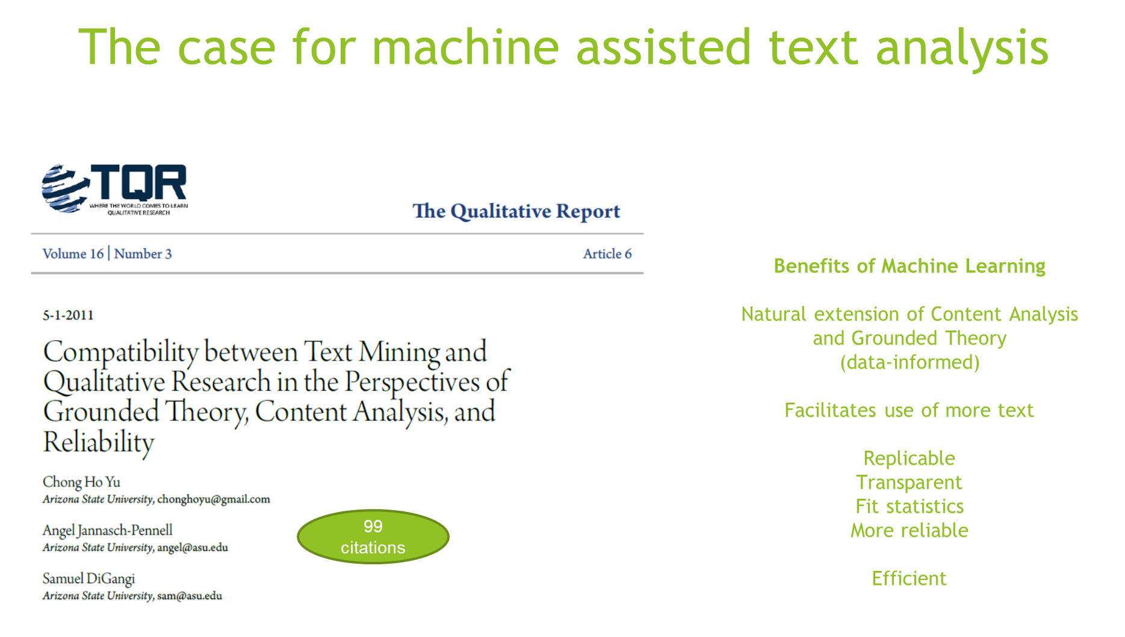
Notes:
Not focused on machine assisted data collection

Slide 13
What is Machine Learning?
Artificial Intelligence
Machine Learning
Deep Learning
AI: Techniques that enables machines to mimic human logic, make predictions, and act on those predictions.
ML: Techniques by which a computer deploys user-defined logical sequences and statistical methods to predict an observed or unobserved class. If predictions are inaccurate, adaptations to the rules are user-defined.
DL: Techniques by which a computer deploys user-defined logical sequences and statistical methods to predict an observed or unobserved class. If predictions are inaccurate, adaptations to the rules are computer generated.
Notes:
ADD visual of neural networks
Add a list of the common equation based too

Slide 14
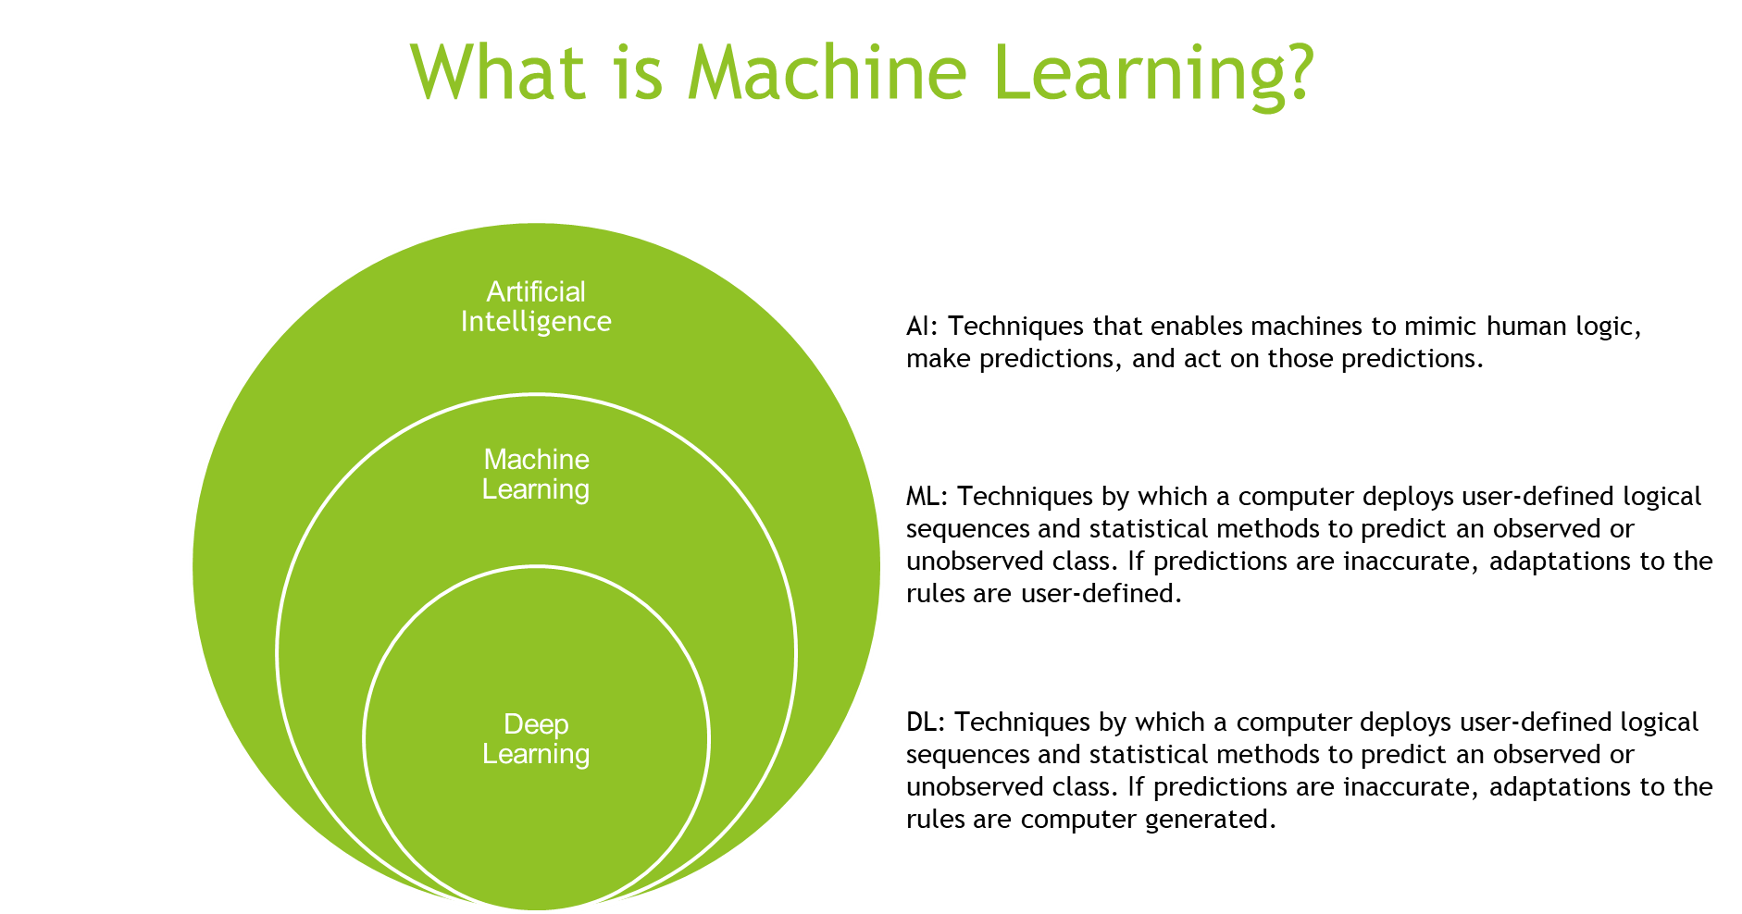
Notes:
ADD visual of neural networks
Add a list of the common equation based too

Slide 15
Equations and Algorithms
 | Equations | Algorithms
 | Column-based Relationships among variables relative to all observations Measures of uncertainty (model fit) well developed Statistics | Row-based Relationships among observations relative to all variables Measures of uncertainty less well developed Computer Science/Engineering
Predicting observed outcomes | Regressions | Supevised Machine Learning
Predicting unobserved outcomes | Factor Analysis Latent Class Analysis Structural Equation Modeling | Unsupervised Machine Learning
Notes:
ADD visual of neural networks
Add a list of the common equation based too

Slide 16
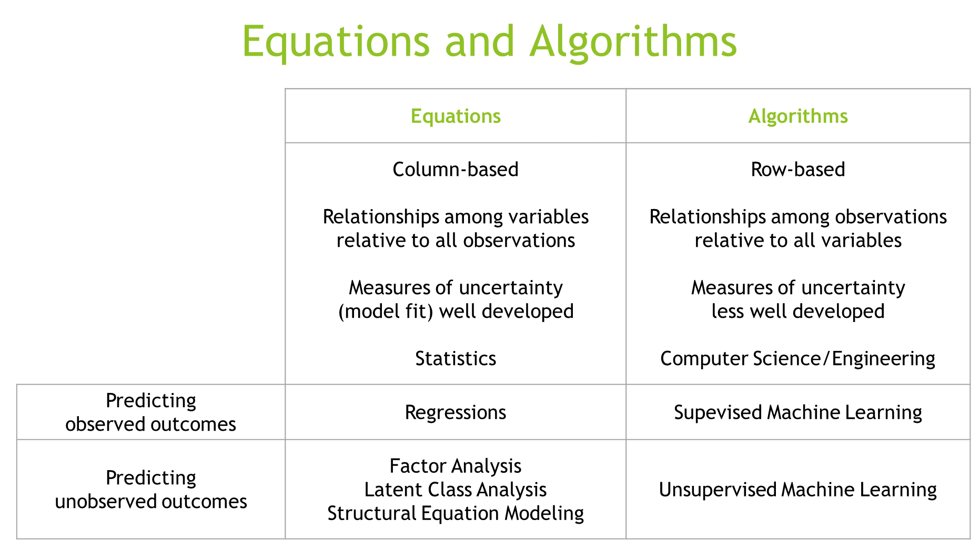
Notes:
ADD visual of neural networks
Add a list of the common equation based too

Slide 17
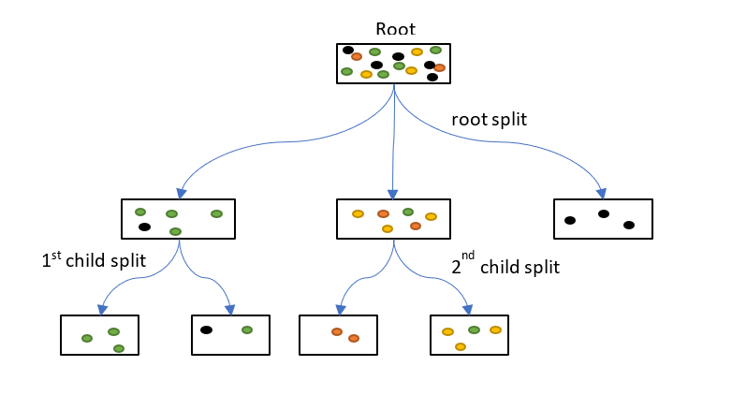
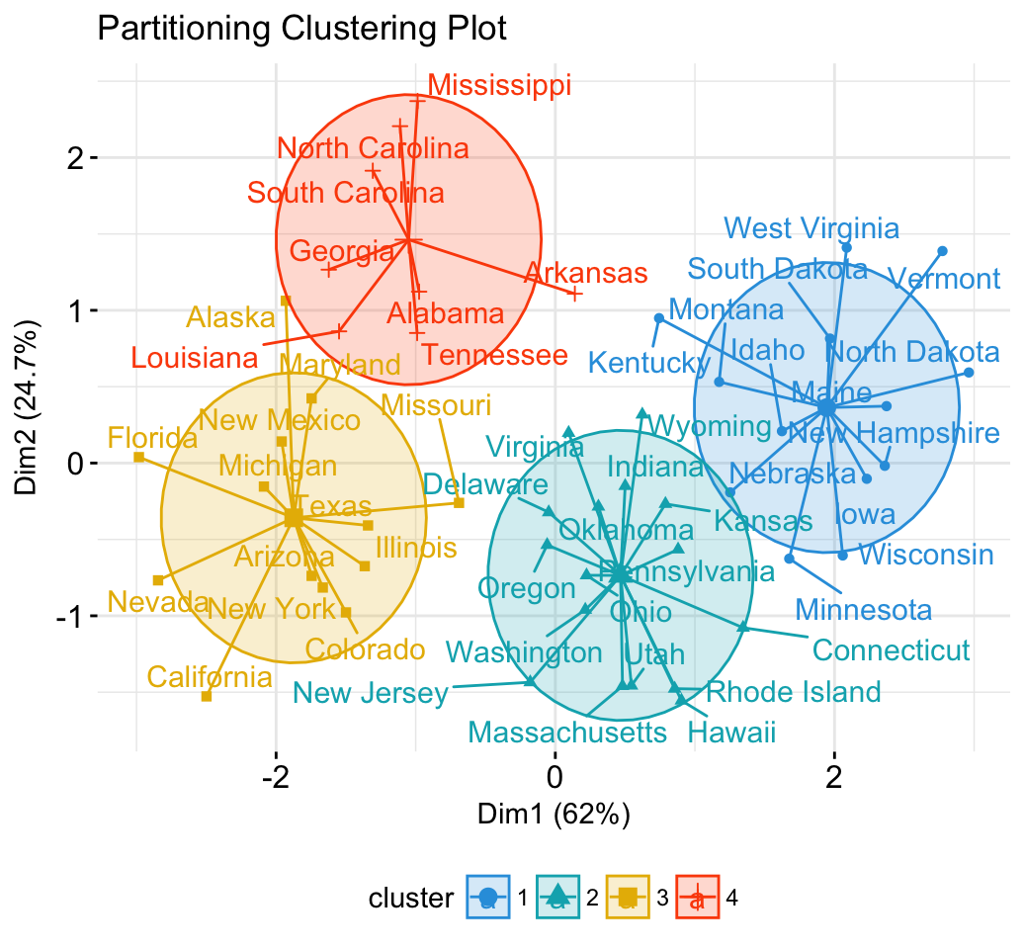
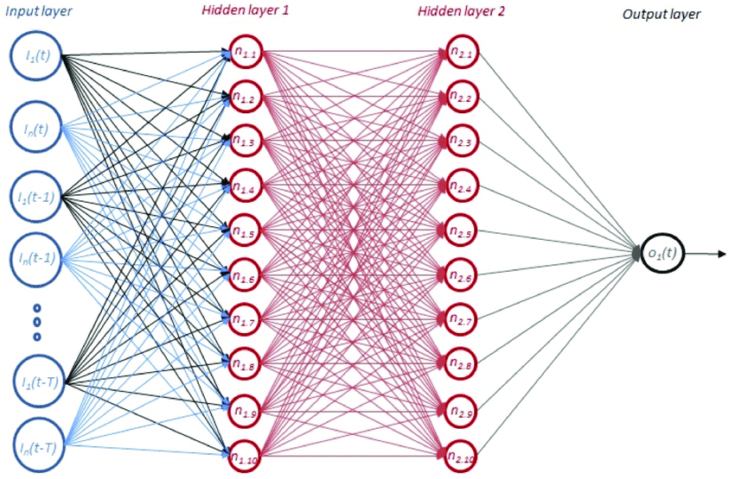
Common Machine Learning Methods
Unsupervised Models
Predicting an unobserved outcome
Supervised Models Predicting an observed outcome
Notes:
ADD visual of neural networks
Add a list of the common equation based too

Slide 18
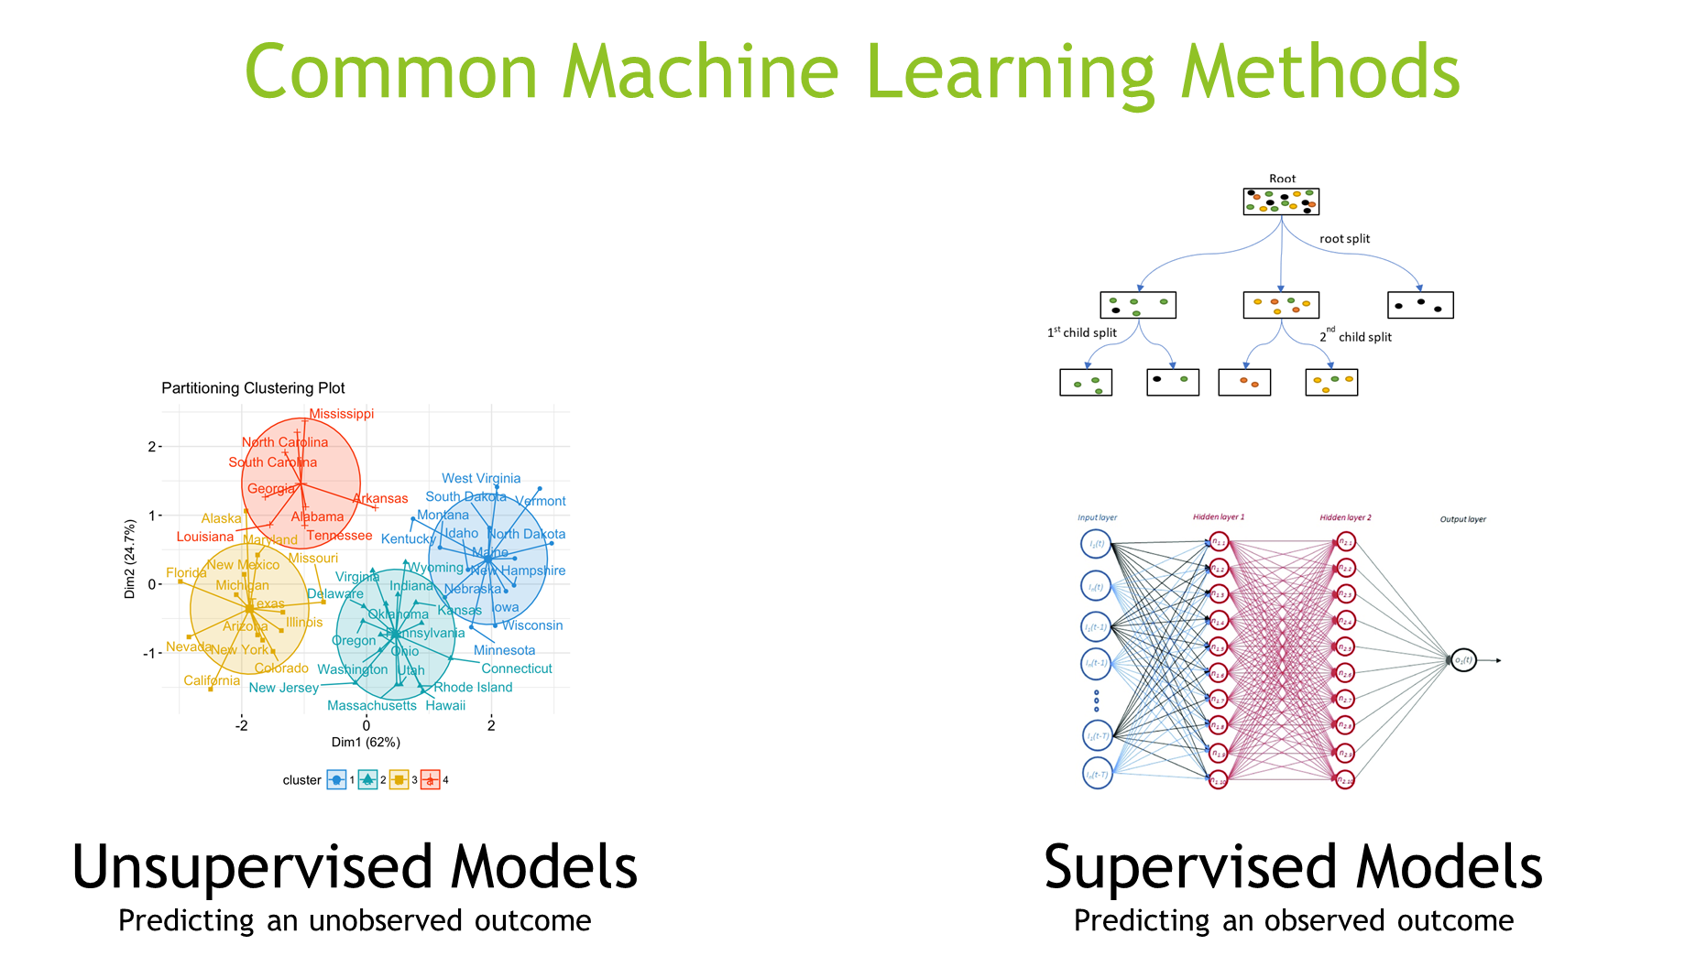
Notes:
ADD visual of neural networks
Add a list of the common equation based too

Slide 19
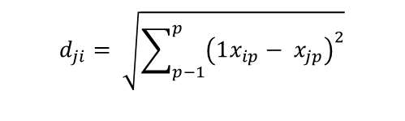
clustering: distance measure
$$d_{ji}= \sqrt{\sum_{p−1}^{p}{{\left(1x_{ip}− x_{jp}\right)}^{2}}}$$
observation | energy | protein | fat | calcium | iron
BEEF BRAISED | 340 | 20 | 28 | 9 | 2.6
HAMBURGER | 245 | 21 | 17 | 9 | 2.7
BEEF ROAST | 420 | 15 | 39 | 7 | 2.0
BEEF STEAK | 375 | 19 | 32 | 9 | 2.6
Notes:
Overview
ML groups observations/individuals with similar experiences -- person-based
Traditional “theming” in qualitative research -- and equation-based models I
n quantitative analysis -- are variable-based
Add the visual of deep/machine/AI

Slide 20
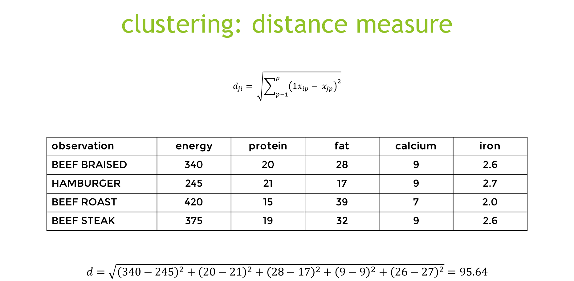
Notes:
ADD visual of neural networks
Add a list of the common equation based too

Slide 21
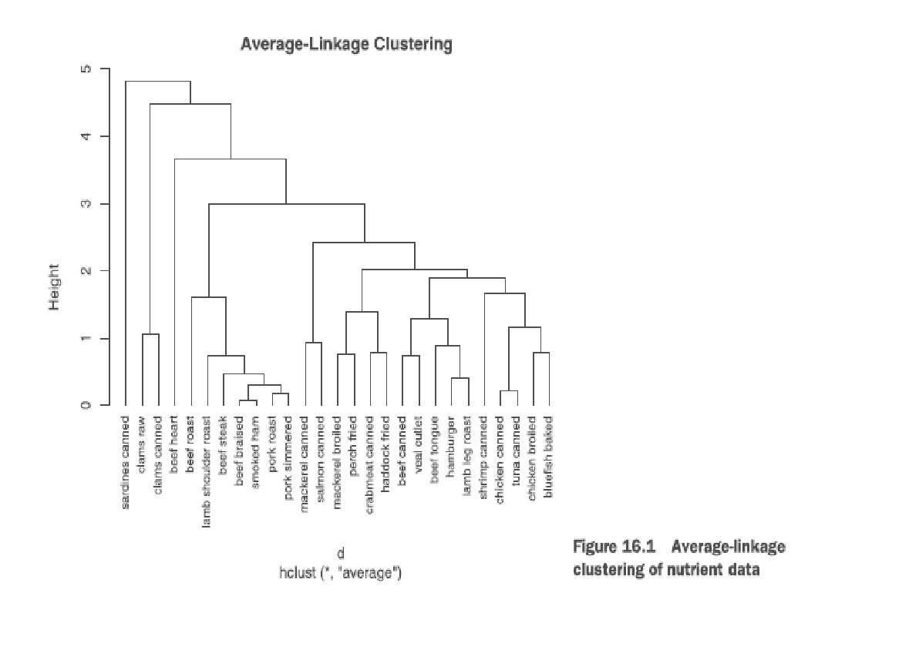
hierarchical
Logic
1. Each case or observation starts as its own cluster.
2. Clusters are combined two at a time until all clusters are merged into a single cluster.
Algorithm
1. Define each observation (row, case) as a cluster.
2. Calculate the distances between every cluster and every other cluster.
3. Combine the two clusters that have the smallest distance. This reduces the num­ber of clusters by one.
4. Repeat steps 2 and 3 until all clusters have been merged into a single cluster containing all observations.
cluster | energy | protein | fat | calcium | iron
1 | 340 | 19 | 29 | 9 | 2.50
2 | 170 | 20 | 8 | 13 | 1.45
3 | 160 | 26 | 5 | 14 | 5.9
4 | 57 | 9 | 1 | 78 | 5.70
5 | 180 | 22 | 9 | 367 | 2.5
Kabacoff, R. I., (2015). Chapter 16: Cluster analysis. In R in Action: Data analysis and graphics with R (2nd Edition). Manning, Shelter Island.
Notes:
Overview
ML groups observations/individuals with similar experiences -- person-based
Traditional “theming” in qualitative research -- and equation-based models in quantitative analysis -- are variable-based

Slide 22
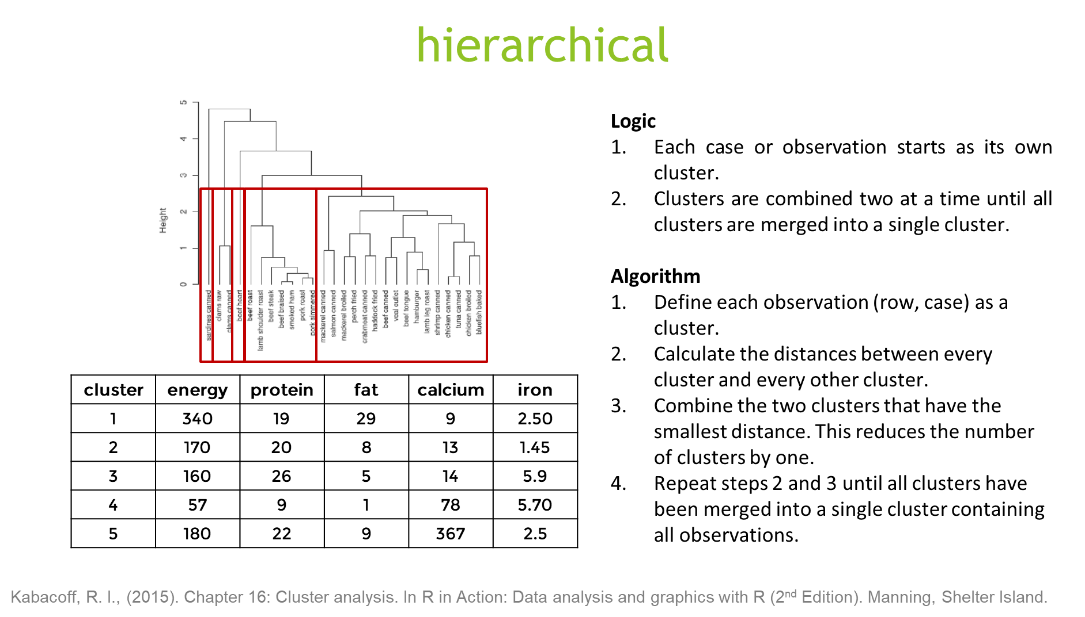
Notes:
Overview
ML groups observations/individuals with similar experiences -- person-based
Traditional “theming” in qualitative research -- and equation-based models in quantitative analysis -- are variable-based

Slide 23
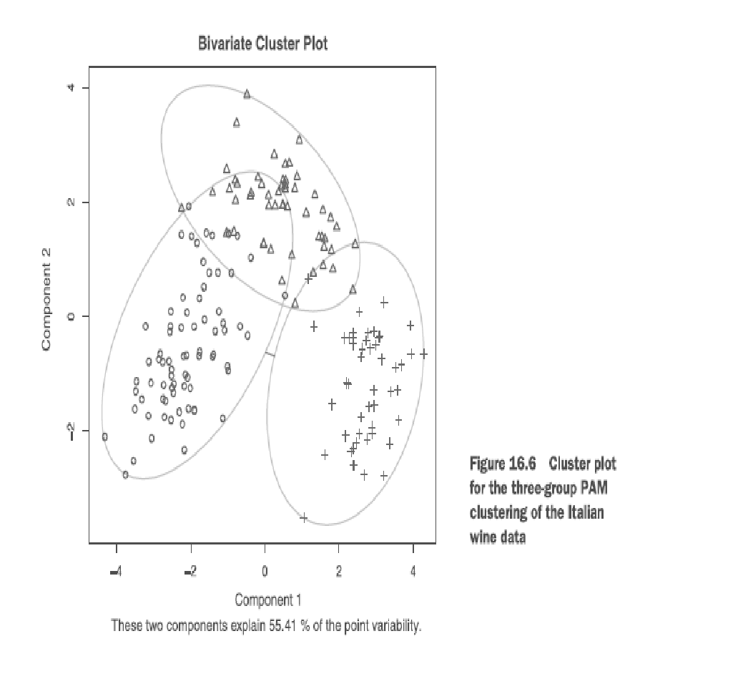
partitioning: k-means and PAM
Logic
1. Observations divided into K groups.
2. Observations are reshuffled to form the most cohesive clusters possible.
Algorithm
1. Select K centroids (K rows chosen at random).
2. Assign each data point to its closest centroid.
3. Recalculate the centroids as the average of all data points in a cluster.
4. Assign data points to their closest centroids.
5. Continue steps 3 and 4 until observations aren't reassigned or the maximum number of iterations is reached.
Kabacoff, R. I., (2015). Chapter 16: Cluster analysis. In R in Action: Data analysis and graphics with R (2nd Edition). Manning, Shelter Island.
Notes:
Overview
ML groups observations/individuals with similar experiences -- person-based
Traditional “theming” in qualitative research -- and equation-based models in quantitative analysis -- are variable-based

Slide 24
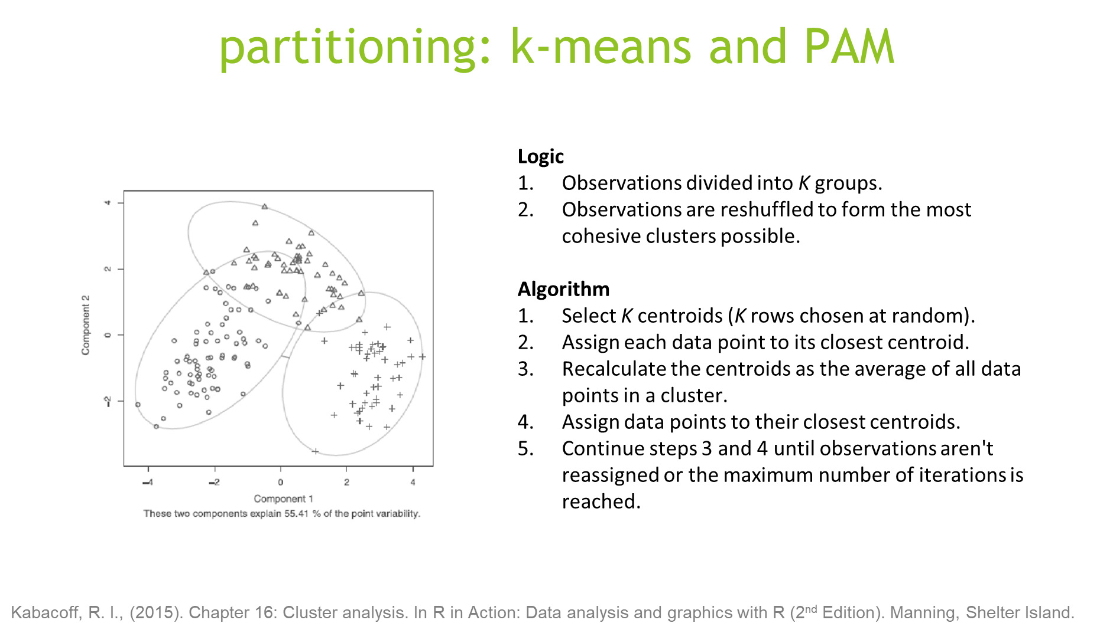
Notes:
Overview
ML groups observations/individuals with similar experiences -- person-based
Traditional “theming” in qualitative research -- and equation-based models in quantitative analysis -- are variable-based

Slide 26
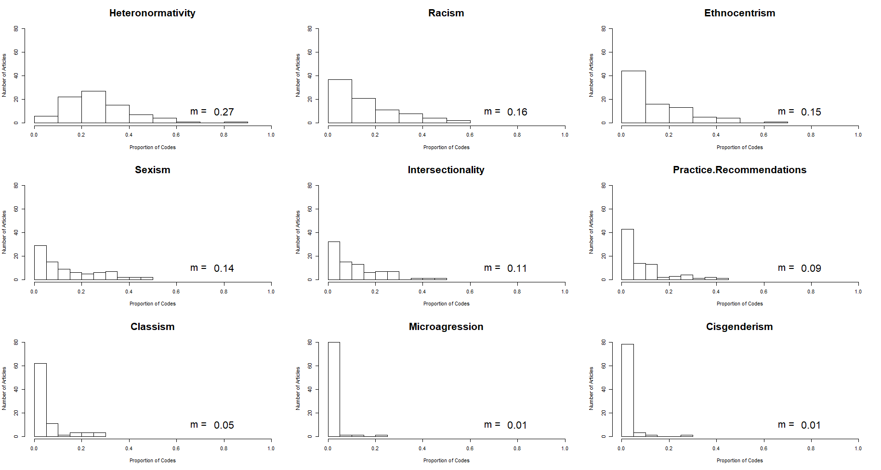
Codes distribution
Notes:
Each code as a percent of all codes for each article
Sorted from most common code to least common code
Does not include micro practice, macro practice, and abelism which all have a mean of 0%
Add key to cluster plots
Discuss column vs row based analysis
Put all the direct output on 1 slide

Slide 27
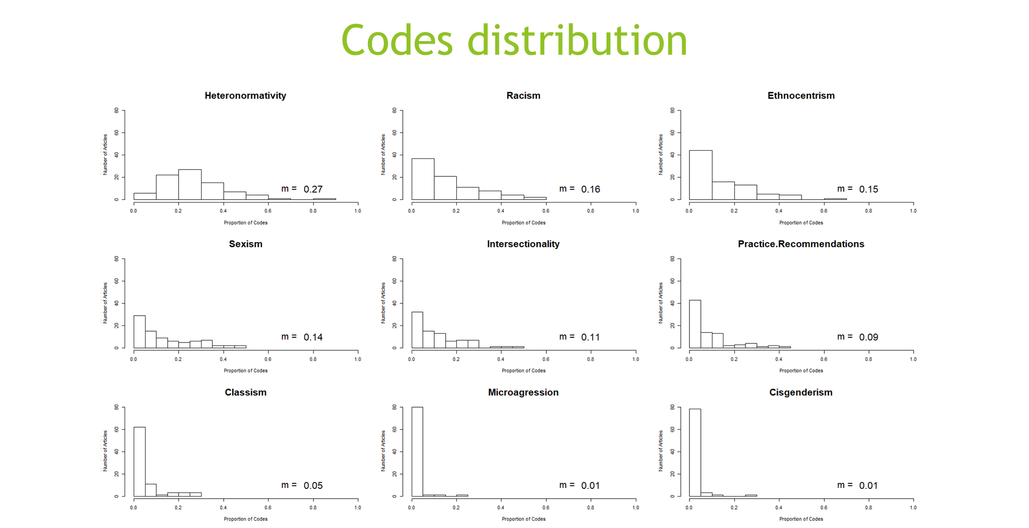
Notes:
Each code as a percent of all codes for each article
Sorted from most common code to least common code
Does not include micro practice, macro practice, and abelism which all have a mean of 0%
Add key to cluster plots
Discuss column vs row based analysis
Put all the direct output on 1 slide

Slide 28
How many clusters?
*******************************************************************
* Among all indices:
* 3 proposed 2 as the best number of clusters
* 4 proposed 3 as the best number of clusters
* 1 proposed 4 as the best number of clusters
* 1 proposed 5 as the best number of clusters
* 6 proposed 6 as the best number of clusters
* 1 proposed 7 as the best number of clusters
* 3 proposed 9 as the best number of clusters
* 1 proposed 13 as the best number of clusters
* 3 proposed 20 as the best number of clusters
***** Conclusion *****
* According to the majority rule, the best number of clusters is 6
*******************************************************************
Notes:
WSS -- skree plot
This suggests 4 clusters exist

Slide 29
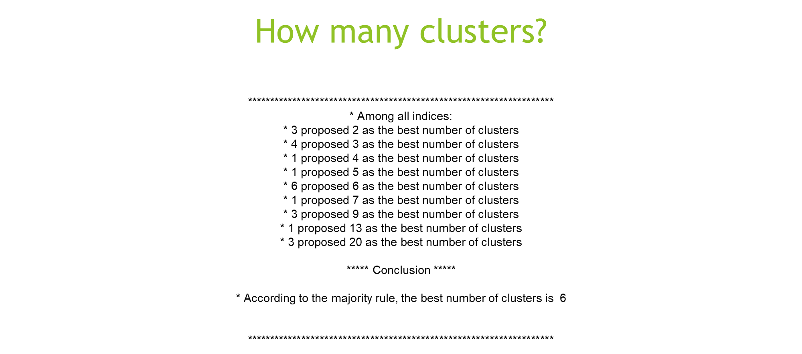
Notes:
WSS -- skree plot
This suggests 4 clusters exist

Slide 30
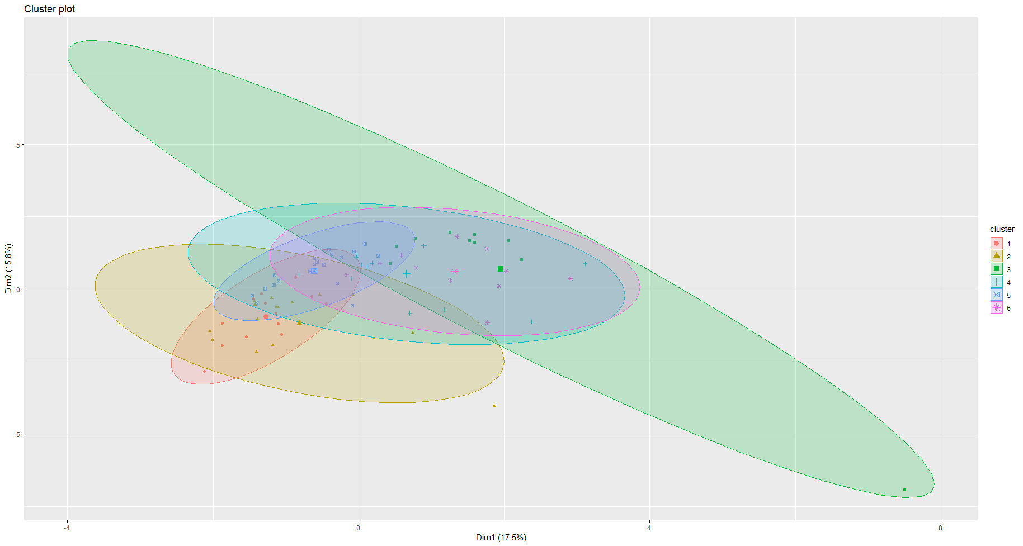
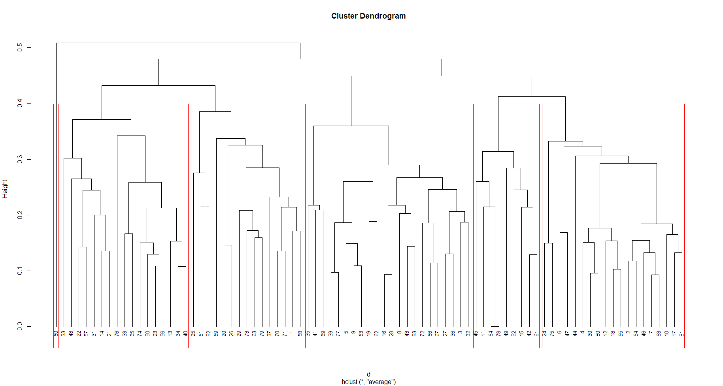
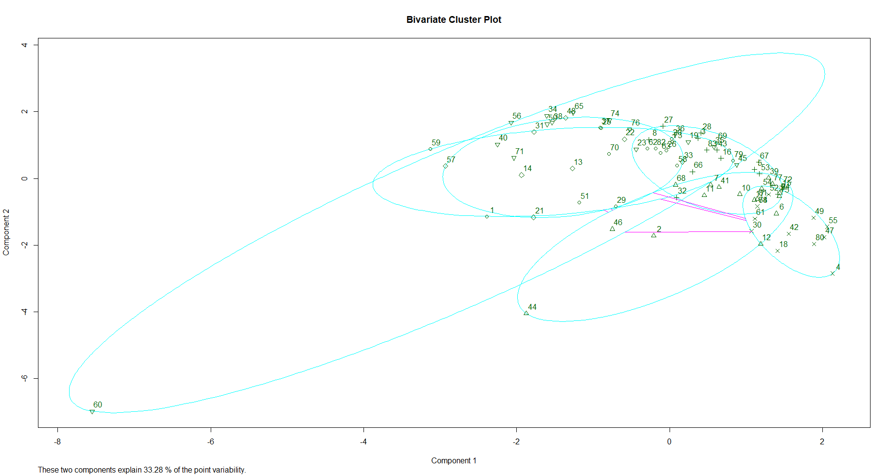
Comparing Models
1 | 2 | 3 | 4 | 5 | 6
14 | 16 | 10 | 13 | 19 | 11
1 | 2 | 3 | 4 | 5 | 6
15 | 19 | 22 | 9 | 17 | 1
1 | 2 | 3 | 4 | 5 | 6
16 | 17 | 15 | 13 | 8 | 14

Slide 31
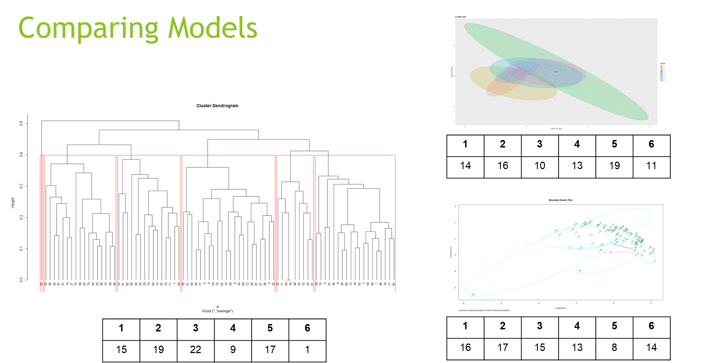

Slide 32
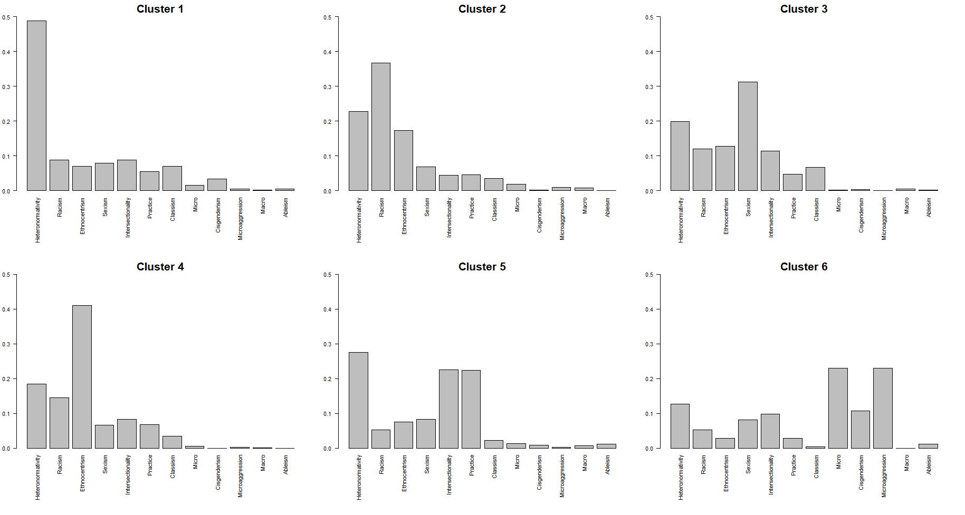
Hierarchical Clusters
n=15
n=19
n=22
n=9
n=17
n=1

Slide 33
Questions / Discussion
Notes:
new side – the excel spreadsheet

Slide 34
Machine Learning with R using Qualitative Research Codes
Marla Stuart, PhD, MSW
Fellow, Berkeley Institute for Data Science
Fellow, Guizhou Berkeley Big Data Innovation Research Center
March 13, 2019
Notes:
11:30-11:40 = Berkeley Time
11:40-11:45 = D-Lab Welcome
11:45-11:50 = Introductions and Agenda
11:50-12:00 = Qualitative Research Coding & Analysis
12:00-12:25 = Machine Learning with R using Qualitative Research Codes
12:25-12:50 = Q&A
12:50-13:00 = Wrap-Up & Evals

Slide 35
It’s Okay Not to Know (IOKN2K)
280 workshops
1,100 consultations
working groups
special research projects
approx. 6,000 scholars served per year
Notes:
5 minutes
workshops on R, python, qual methods, etc.
couple to a few dozen consultants providing around 1100 consultations per year
working groups: Digital Humanities, Education, Cloud Computing, Computational Text Analysis, Learning Analytics, Blockchain/Cryptocurrency, Qualitative Methods, Python & Machine Learning…
working groups range from 10 to 30, with an average of 12 participants, meeting an average of twice per month
special research projects include Hate Speech, College-Going Patterns, Digital Refugees, & Digital Humanities Projects, such as Louisiana Slave Conspiracies

Slide 36
Agenda
Introductions
Qualitative Research Coding & Analysis (Josué)
Machine Learning with R using
Qualitative Research Codes (Marla)
Exporting Code Counts into Excel
Grouping Data Sources using R
?
?
?
?
?
Notes:
5 minutes
Introductions & Agenda (5 minutes)
Qual Research Coding & Analysis (10 minutes)
Machine Learning with R using Qual Research Codes (50 minutes, including Q&A)

Slide 37
Qualitative Research Coding & Analysis What are Codes? What is Coding
Coding is a way of organizing the data around some common idea, concept, or category ACROSS sources.
The code of “financial planning” is applied to the selected text from documents A, B, and C, because they all discuss this topic.
A B C
Notes:
3 minutes
Use example of blue text being a code of “program development” and orange text being the code of “program termination” and then discuss how these codes can help us understanding different concepts/ideas…
Deductive and Inductive Coding You create codes because you deem the identified topics/concepts/ideas as important and relevant to your study. Deductive Coding: Codes emerge from your research question and/or the literature review. Inductive Coding: Codes emerge through engagement with your actual data sources and/or data set.
Defining Codes Your codes should be defined, just as variables in a quantitative study should be defined. The level of specificity will depend on various factors, such as the complexity of your coding scheme, whether you have a team of coders or are conducting coding on your own, requirements of your field or committee or journal of choice… Inclusion/Exclusion Criteria, Weighing Scale
Organization of Coding Scheme Whether deductive or inductive, codes are organized into a coding scheme that you then use to systematically identify relevant segments of data within your entire data set. Flat Coding: Codes are organized at the same conceptual level. Hierarchical Coding: Codes are organized into groups and subgroups based on whatever conceptualization the researcher deems appropriate/relevant.

Slide 38
Qualitative Research Coding & Analysis
Multi-Step Nonlinear Process
Coding
Unit of Analysis
Metadata
Research Questions
Literature or Theory
Data
Codes
Memos
Notes:
2 minutes
Different researchers engage the coding process in different ways… However you choose to create and organize codes, you should expect it will be a multi-step process, maybe 4, 5, or more rounds, and that there will be a great deal of “back-and-forth” throughout the process.

Slide 39
Qualitative Research Coding & Analysis
Best Practices
Treat Coding as an Iterative Process
Test and Revise Codes
Review Coding Process
Actively Work with 20-30 Codes at a Time
Break Up the Coding Process
Keep a Codebook
Memo as You Code
Notes:
1 minute
Treat Coding as an Iterative Process Test Codes and Revise: Look for codes that aren’t being used, aren’t distinct enough from other codes, are defined too broad or too specific… Review Coding Process: Make sure you and other coders are being consistent in your application of the codes across the data set.
Actively Work with 20-30 Codes at a Time You’ll likely have more than 20-30 codes, but should actively code with only 20-30 codes to ensure consistency.
Break Up the Coding Process You can code for a specific chapter rather than the whole dissertation/book. You can split the codebook thematically, and code in rounds.
Keep a Codebook Include information noted on “Defining Codes” slide, and regularly refer back to it. This is a living document that should be revised as needed.
Memo as You Code Make notes reflecting on the coding process, perhaps noting ideas for codes that aren’t yet included and/or revisions to existing codes. You may also write analytic memos, making a note that reflects initial thoughts about the meaning of your work (i.e., preliminary analysis)

Slide 40
Qualitative Research Coding & Analysis
What is Analysis?
Analysis
Unit of Analysis
Metadata
Research Questions
Literature or Theory
Data
Codes
Memos
Analysis Plan
Code/Query Output
Memos
Notes:
2 minutes
The process of identifying themes related to your research findings. This is different than identifying ideas/concepts/topics that come up throughout your data set. It’s “bigger picture” stuff…
Overarching Themes: What is happening in your data overall? Subgroup Themes: What is happening in your data for specific subgroups? Typology Themes: What is happening in your data by specific dimensions of coded data?
for typology, give example of financial planning and program development… where you may notice there are certain groups of administrators or certain agencies or certain cities (whatever your studying) that approach financial planning and program development for social services in different ways… Perhaps you notice some are social justice oriented, making decisions based primarily on client/community needs, others are fiscally driven, making decisions based primarily on maintaining a balanced budget, while others may be incentive driven, making decisions focused on disincentivizing the use of social welfare and incentivizing the use of work. Your may divide your data into three typologies: social justice oriented, fiscally oriented, and work incentive oriented.
An analysis plan is a living document that you revise as you discover new questions, add codes to the codebook, and revise your plan based on null findings. The plan should document:
Research Question(s) You Want to Answer: Identify Specific Question(s) to Answer
Codes, Attributes, and Queries You’ll Use to Answer Each Question (identify which of these to use to answer each question)
Relevant Themes, Subgroups, and Typologies
Multi-Step Nonlinear Process These questions will be more specific than the research questions that motivate your study, and will focus on your actual data. Identify Codes, Attributes, Subgroups, Typologies, and Queries Associated with the Specific Questions Which help answer the specific question? What aspects of these are you interested in? What unit of analysis is important to answer your question (e.g., individual or group, stakeholder type, document of a particular era)?
If you have a hypothesis, plan to test both to prove and disprove. How might the concepts/ideas/categories for which you coded contribute to your research question?

Slide 41
QDA Software as a Tool for Coding & Analysis
What It Does
Structure & Organize
Code & Retrieve
Memo
Explore
Query
Visualize
Potential Benefits
Frees Time to Focus on Analysis
Can Deal with Large Data Sets
Improves Auditability
(among some audiences)
Improves Credibility
(among some audiences)
What It Does Not
Error-Free Auto Coding
Analytic Thinking
Eliminate Bias
Advanced Quantitative Analysis
MAXQDA engages in some quantitative analysis
Potential Drawbacks
Requires Learning the Software
May Force Production of Meaningless Findings
May Create Pressure to Engage Excessive Features
Notes:
1 minute

Slide 42
Overview of Relevant Software Programs
QDA Miner
HyperResearch
ANSWR
Transana
Aquad (open source)
Quirkos (visual exports)
Saturate (app-based)
Notes:
1 minute

Slide 43
Qualitative Research and Machine Learning
Notes:
Review article that recommends it
As a way to theme
Add references to last slide
Show some examples from other articles?

Slide 44
The case for machine assisted text analysis
Benefits of Machine Learning
Natural extension of Content Analysis and Grounded Theory (data-informed)
Facilitates use of more text
Replicable
Transparent
Fit statistics
More reliable
Efficient
99 citations
Notes:
Not focused on machine assisted data collection

Slide 45
Notes:
Not focused on machine assisted data collection

Slide 46
What is Machine Learning?
Artificial Intelligence
Machine Learning
Deep Learning
AI: Techniques that enables machines to mimic human logic, make predictions, and act on those predictions.
ML: Techniques by which a computer deploys user-defined logical sequences and statistical methods to predict an observed or unobserved class. If predictions are inaccurate, adaptations to the rules are user-defined.
DL: Techniques by which a computer deploys user-defined logical sequences and statistical methods to predict an observed or unobserved class. If predictions are inaccurate, adaptations to the rules are computer generated.
Notes:
ADD visual of neural networks
Add a list of the common equation based too

Slide 47
Notes:
ADD visual of neural networks
Add a list of the common equation based too

Slide 48
Equations and Algorithms
 | Equations | Algorithms
 | Column-based Relationships among variables relative to all observations Measures of uncertainty (model fit) well developed Statistics | Row-based Relationships among observations relative to all variables Measures of uncertainty less well developed Computer Science/Engineering
Predicting observed outcomes | Regressions | Supevised Machine Learning
Predicting unobserved outcomes | Factor Analysis Latent Class Analysis Structural Equation Modeling | Unsupervised Machine Learning
Notes:
ADD visual of neural networks
Add a list of the common equation based too

Slide 49
Notes:
ADD visual of neural networks
Add a list of the common equation based too

Slide 50
Common Machine Learning Methods
Unsupervised Models
Predicting an unobserved outcome
Supervised Models Predicting an observed outcome
Notes:
ADD visual of neural networks
Add a list of the common equation based too

Slide 51
Notes:
ADD visual of neural networks
Add a list of the common equation based too

Slide 52
clustering: distance measure
$$d_{ji}= \sqrt{\sum_{p−1}^{p}{{\left(1x_{ip}− x_{jp}\right)}^{2}}}$$
observation | energy | protein | fat | calcium | iron
BEEF BRAISED | 340 | 20 | 28 | 9 | 2.6
HAMBURGER | 245 | 21 | 17 | 9 | 2.7
BEEF ROAST | 420 | 15 | 39 | 7 | 2.0
BEEF STEAK | 375 | 19 | 32 | 9 | 2.6
Notes:
Overview
ML groups observations/individuals with similar experiences -- person-based
Traditional “theming” in qualitative research -- and equation-based models I
n quantitative analysis -- are variable-based
Add the visual of deep/machine/AI

Slide 53
Notes:
ADD visual of neural networks
Add a list of the common equation based too

Slide 54
hierarchical
Logic
1. Each case or observation starts as its own cluster.
2. Clusters are combined two at a time until all clusters are merged into a single cluster.
Algorithm
1. Define each observation (row, case) as a cluster.
2. Calculate the distances between every cluster and every other cluster.
3. Combine the two clusters that have the smallest distance. This reduces the num­ber of clusters by one.
4. Repeat steps 2 and 3 until all clusters have been merged into a single cluster containing all observations.
cluster | energy | protein | fat | calcium | iron
1 | 340 | 19 | 29 | 9 | 2.50
2 | 170 | 20 | 8 | 13 | 1.45
3 | 160 | 26 | 5 | 14 | 5.9
4 | 57 | 9 | 1 | 78 | 5.70
5 | 180 | 22 | 9 | 367 | 2.5
Kabacoff, R. I., (2015). Chapter 16: Cluster analysis. In R in Action: Data analysis and graphics with R (2nd Edition). Manning, Shelter Island.
Notes:
Overview
ML groups observations/individuals with similar experiences -- person-based
Traditional “theming” in qualitative research -- and equation-based models in quantitative analysis -- are variable-based

Slide 55
Notes:
Overview
ML groups observations/individuals with similar experiences -- person-based
Traditional “theming” in qualitative research -- and equation-based models in quantitative analysis -- are variable-based

Slide 56
partitioning: k-means and PAM
Logic
1. Observations divided into K groups.
2. Observations are reshuffled to form the most cohesive clusters possible.
Algorithm
1. Select K centroids (K rows chosen at random).
2. Assign each data point to its closest centroid.
3. Recalculate the centroids as the average of all data points in a cluster.
4. Assign data points to their closest centroids.
5. Continue steps 3 and 4 until observations aren't reassigned or the maximum number of iterations is reached.
Kabacoff, R. I., (2015). Chapter 16: Cluster analysis. In R in Action: Data analysis and graphics with R (2nd Edition). Manning, Shelter Island.
Notes:
Overview
ML groups observations/individuals with similar experiences -- person-based
Traditional “theming” in qualitative research -- and equation-based models in quantitative analysis -- are variable-based

Slide 57
Notes:
Overview
ML groups observations/individuals with similar experiences -- person-based
Traditional “theming” in qualitative research -- and equation-based models in quantitative analysis -- are variable-based

Slide 59
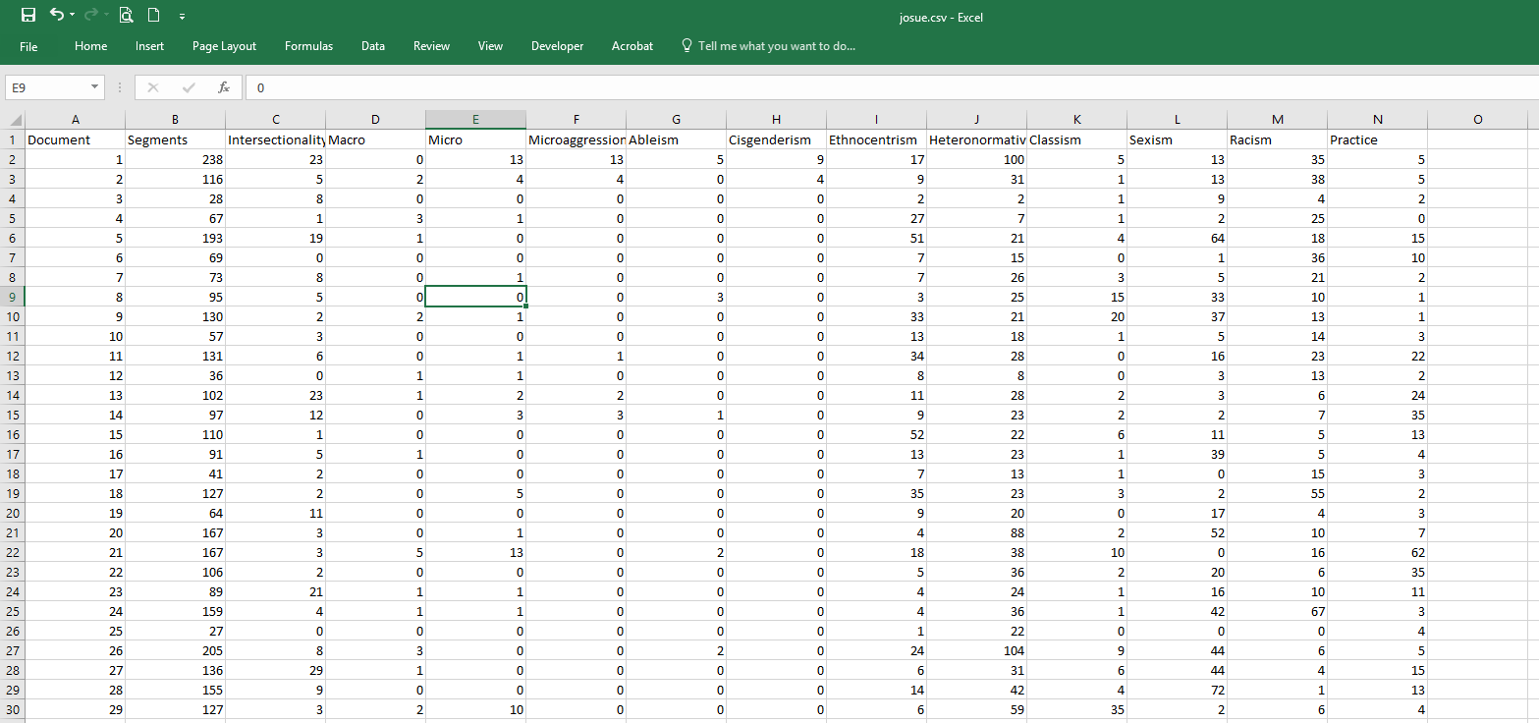
Data (codes)
Notes:
Each code as a percent of all codes for each article
Sorted from most common code to least common code
Does not include micro practice, macro practice, and abelism which all have a mean of 0%
Add key to cluster plots
Discuss column vs row based analysis
Put all the direct output on 1 slide

Slide 60
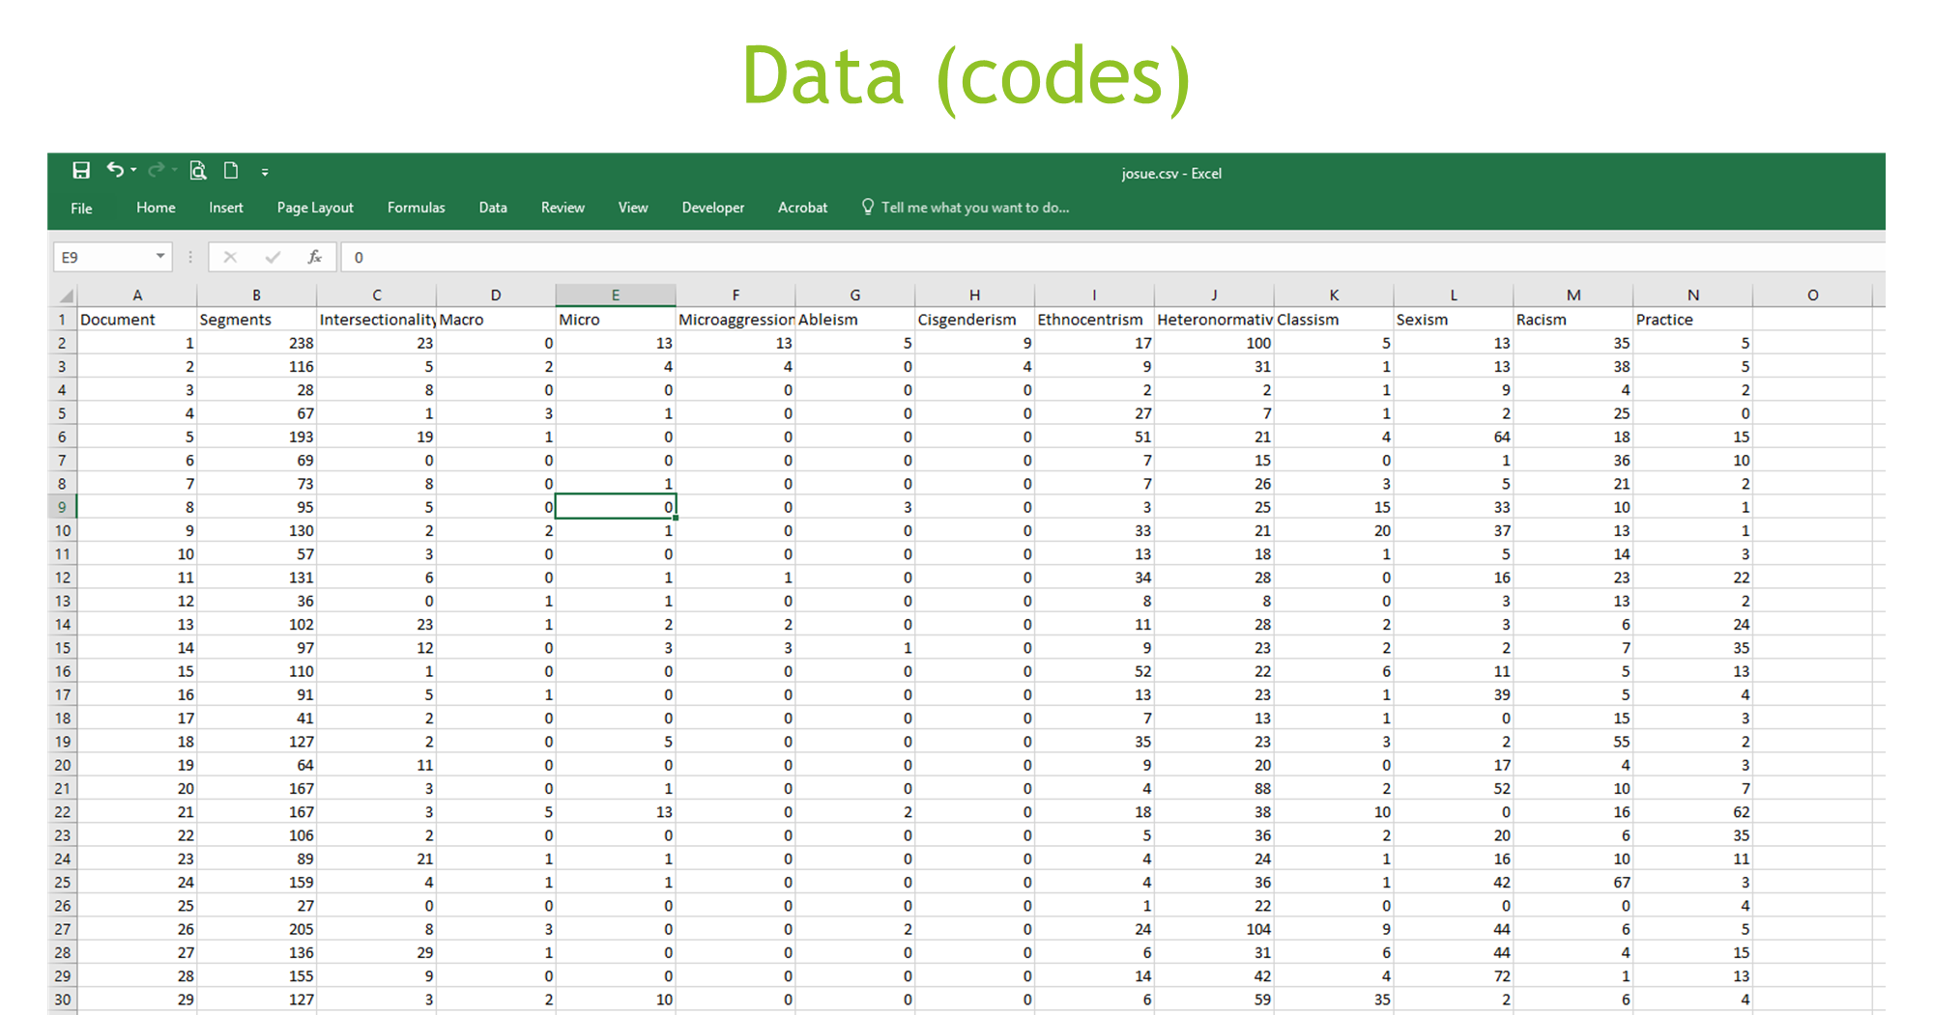
Notes:
Each code as a percent of all codes for each article
Sorted from most common code to least common code
Does not include micro practice, macro practice, and abelism which all have a mean of 0%
Add key to cluster plots
Discuss column vs row based analysis
Put all the direct output on 1 slide

Slide 61
Codes distribution
Notes:
Each code as a percent of all codes for each article
Sorted from most common code to least common code
Does not include micro practice, macro practice, and abelism which all have a mean of 0%
Add key to cluster plots
Discuss column vs row based analysis
Put all the direct output on 1 slide

Slide 62
Notes:
Each code as a percent of all codes for each article
Sorted from most common code to least common code
Does not include micro practice, macro practice, and abelism which all have a mean of 0%
Add key to cluster plots
Discuss column vs row based analysis
Put all the direct output on 1 slide

Slide 63
How many clusters?
*******************************************************************
* Among all indices:
* 3 proposed 2 as the best number of clusters
* 4 proposed 3 as the best number of clusters
* 1 proposed 4 as the best number of clusters
* 1 proposed 5 as the best number of clusters
* 6 proposed 6 as the best number of clusters
* 1 proposed 7 as the best number of clusters
* 3 proposed 9 as the best number of clusters
* 1 proposed 13 as the best number of clusters
* 3 proposed 20 as the best number of clusters
***** Conclusion *****
* According to the majority rule, the best number of clusters is 6
*******************************************************************
Notes:
WSS -- skree plot
This suggests 4 clusters exist

Slide 64
Notes:
WSS -- skree plot
This suggests 4 clusters exist

Slide 65
Comparing Models
1 | 2 | 3 | 4 | 5 | 6
14 | 16 | 10 | 13 | 19 | 11
1 | 2 | 3 | 4 | 5 | 6
15 | 19 | 22 | 9 | 17 | 1
1 | 2 | 3 | 4 | 5 | 6
16 | 17 | 15 | 13 | 8 | 14

Slide 67
Confirming Model Choice

Slide 68
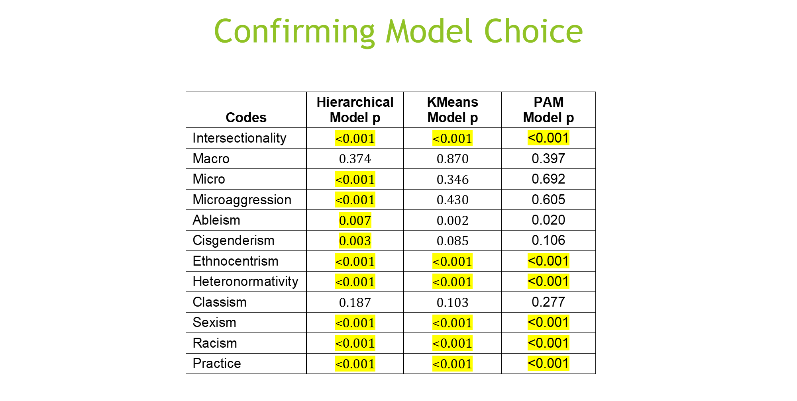

Slide 69
Hierarchical Clusters
Heteronormativity
Racism Heteronormativity, Ethnocentrism
Sexism Heteronormativity
n=15
n=19
n=22
Ethnocentrism Heteronormativity, Racism
Heteronormativity
Intersectionality
Practice Recommendations
Micro Practice
Microaggressions
n=9
n=17
n=1

Slide 70
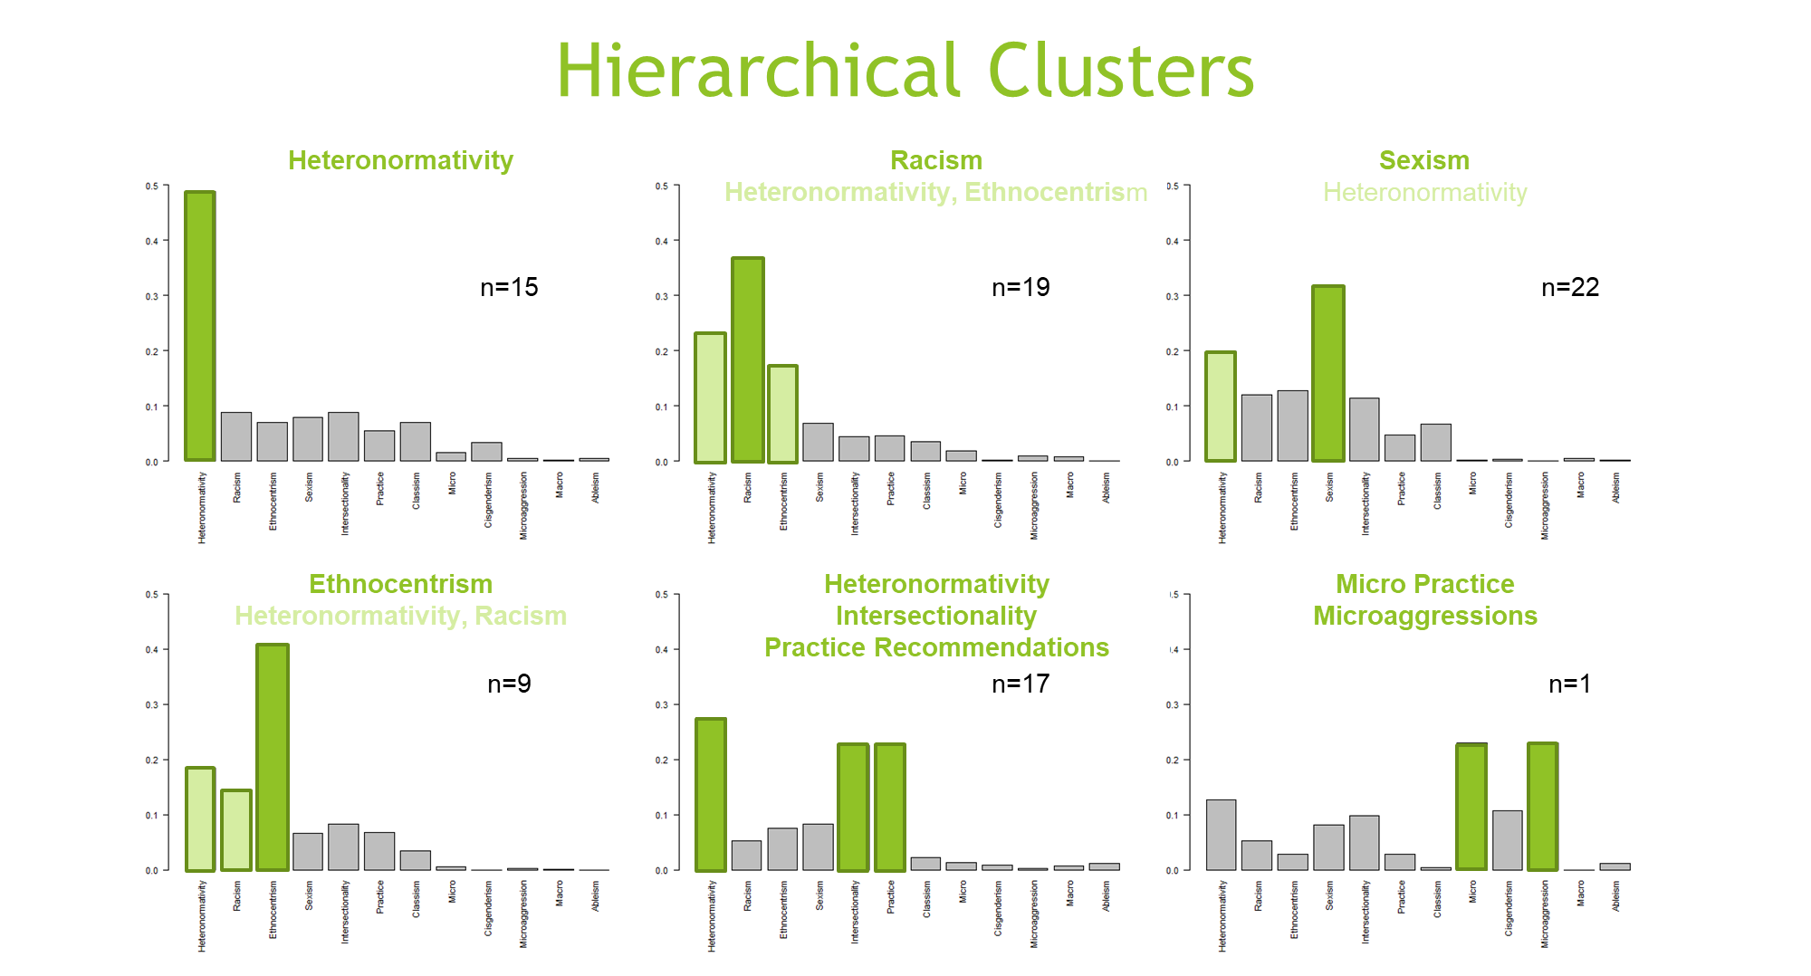

Slide 71
Hierarchical Clusters: Sample Articles
1. Heteronormativity
2.
Racism Heteronormativity, Ethnocentrism
3.
Sexism Heteronormativity
Exploring Biculturality and Beauty Standards in Sexual Minority Women, Psychology of Sexual Orientation and Gender Diversity (2015)
"Antiblackness in Education Policy and Discourse", Theory Into Practice (2016)
"Capitalism and Welfare Reform: Who Really Benefits?", Race, Gender and Class (2008)
4.
Ethnocentrism Heteronormativity, Racism
5.
Heteronormativity
Intersectionality
Practice Recommendations
6.
Micro Practice
Microaggressions
"Discrimination and Substance Use Disorders among Latinos", American Journal of Public Health (2014)
Intersectionality and Social Work: Omissions of Race, Class, and Sexuality in Graduate School Education, Journal of Social Work Education (2016)
Sexual Orientation and Gender Identity Microaggression, Journal of Ethnic and Cultural Diversity in Social Work (2017)

Slide 72
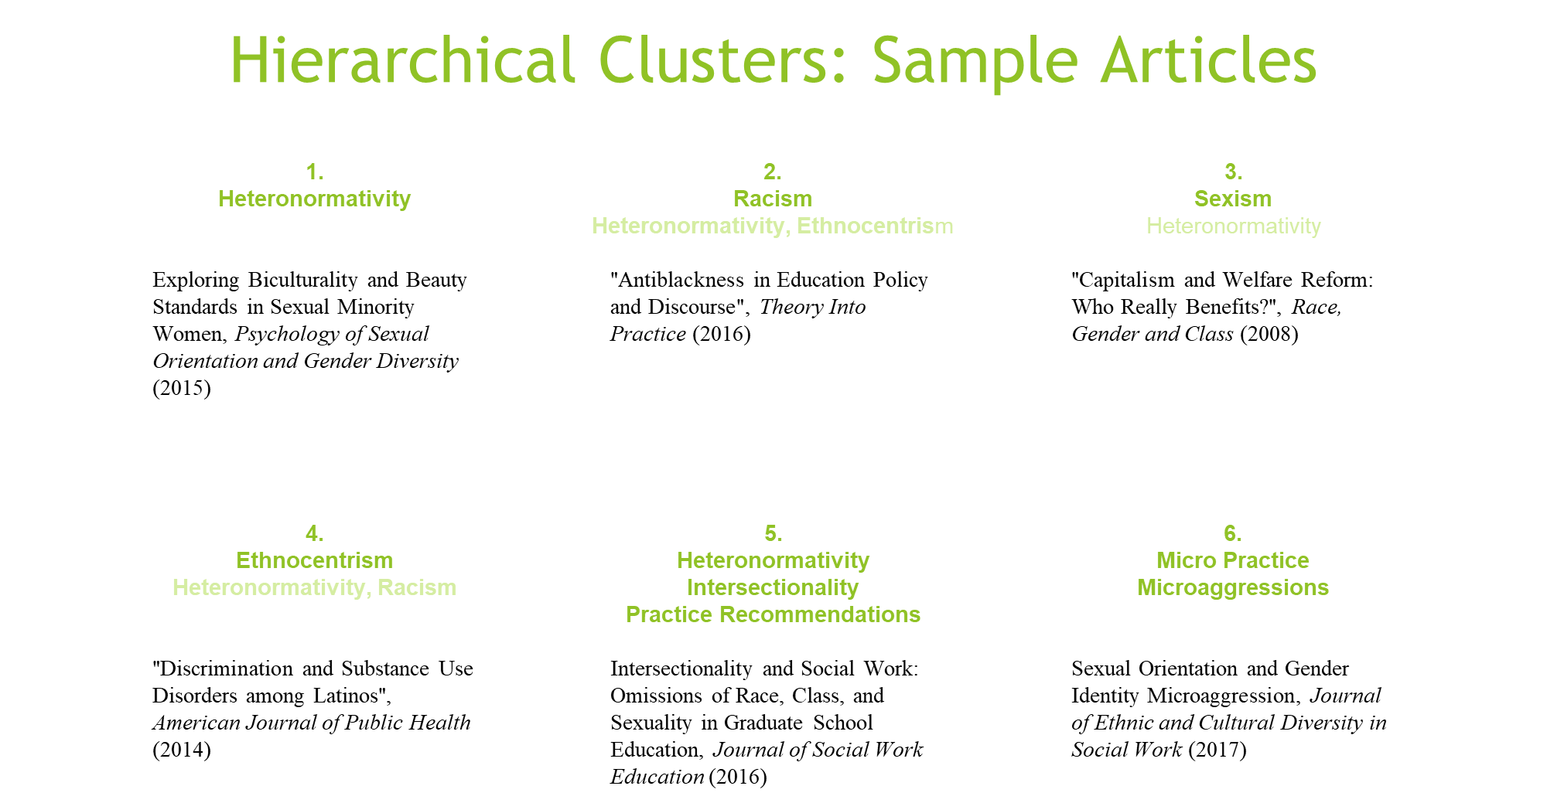

Slide 73
Questions / Discussion
Notes:
new side – the excel spreadsheet

